Slide 1

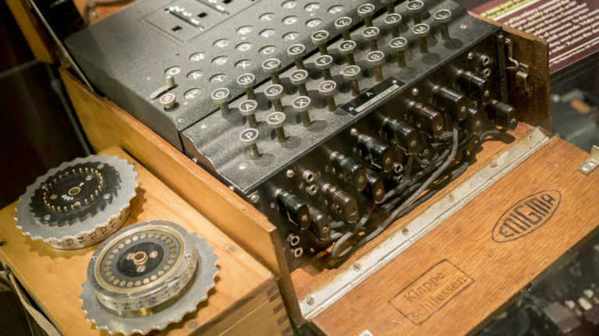

The Enigma Machine
Holland Whitley

Slide 2
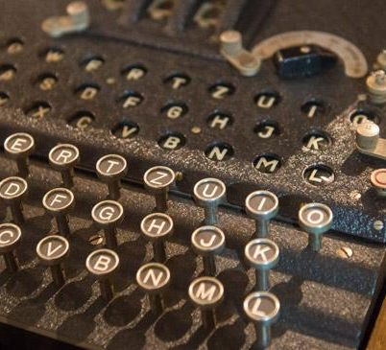
Description
A recreation of the Enigma machine created by Nazi Germany
A study of the efficacy of frequency analysis on the Enigma machine

Slide 3
Purpose
Desire to learn more about encryption
Desire to learn about the Enigma machine
Desire to learn how to create a program for encryption
Desire to tie in both Cybersecurity and Computer Science aspects into project

Slide 4
Problem Statement
Encryption is a hard concept to grasp
Personal experience: didn’t fully understand until taking Security+
Classes only skim over the basics (i.e., asymmetric vs. symmetric encryption)
Dissecting encryption methods will help understand encryption as a whole

Slide 5

Background/research

Slide 6
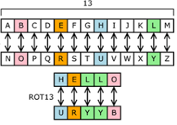
The Basics
The Enigma machine is a series of four substitution ciphers that change at every letter.
Substitution cipher – a cipher in which the letters of plaintext are systematically replaced by substitute letters

Slide 7
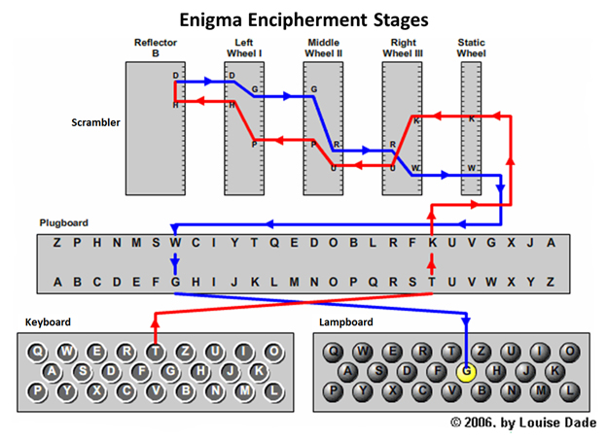
Basic Components
Plugboard – substitution cipher made with physical plugs
Three Rotors – substitution ciphers based on setting
Reflector – substitution cipher
Keyboard
Lampboard

Slide 8
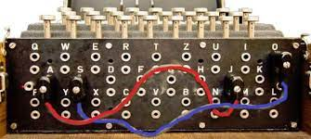
Plugboard, Keyboard, & Lampboard
Keyboard – Input mechanism
Lampboard –Output mechanism
Plugboard – substitution between two letters (A=Z, Z=A), which is made by physical plugs

Slide 9
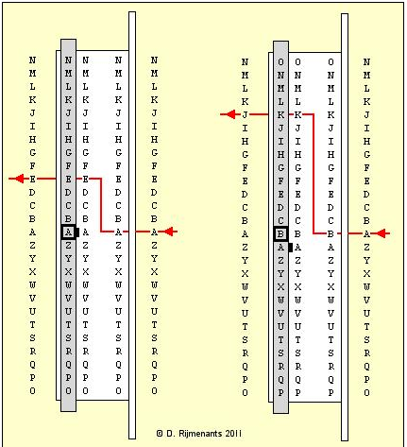

Rotor Settings
Letter setting – shifts initial letter over by the offset of the letter setting
Three Rotor Types (I, II, III) – each rotor can be on either type

Slide 10

Rotor Movement
Movement by Rotor Placement –
Right rotor – increases letter setting at every letter
Middle rotor – increases letter setting at every 26 rotations of the right rotor
Left rotor – increases letter setting at every 26 rotations of the middle rotor
Movement by Rotor Setting –

Slide 11

Reflector Settings
Reflector - A substitution cipher that throws the ciphertext back through the rotors
Does not move, always constant
Does not have any letter settings

Slide 12
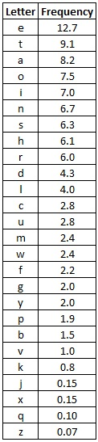
Frequency Analysis
The frequency of letters or groups of letters in a ciphertext can be translated to the frequency of letters or groups of letters in plaintext

Slide 13
Project Languages, Software, and Hardware
Project Language: C++
Project Software: VMware, Ubuntu virtual machine, Vi text editor
Project Hardware: One laptop

Slide 14
Project Requirements
Enigma machine
Plugboard
3 Rotors – with double stepping mechanism
3 Rotor types (I, II, III) from Enigma I
Reflector
Setting B from Enigma I
Frequency Analysis
Determine efficacy on Enigma machine
Explain results

Slide 15
Test Plan - Enigma
Cleartext Phrase: “Hello, my name is Holland”
Test Group1 – control (no plugboard settings, rotor letter settings to ‘a’, rotor type settings to 1)
Test Group 2 – only change plugboard settings
Test Group 3 – only change rotor letter settings
Test Group 4 – only change rotor type settings
Test 5 – only change right rotor letter to ‘q’ to cause double step in right rotor
Test 6 – only change rotor letter settings to ‘q’ to cause double step in all rotors

Slide 16
Test Plan - Enigma
Testing Stages
Plugboard
Plugboard + Right Rotor (Single Stepping)
Plugboard + Right Rotor + Middle Rotor (Single Stepping)
Plugboard + Right Rotor + Middle Rotor + Left Rotor (Single Stepping)
Plugboard + Right Rotor + Middle Rotor + Left Rotor + Reflector (Single Stepping)
Plugboard + Right Rotor + Middle Rotor + Left Rotor + Reflector + Left Rotor + Middle Rotor + Right Rotor + Plugboard (Single and Double Stepping)

Slide 17
Test Plan – Frequency Analysis
Test 1: “The Cask of Amontillado” by Edgar Allen Poe
Test 2: “Rumpelstiltskin” by Brothers Grimm
Test 3: “Chapter 1” from Systems Analysis and Design by Rosenblatt

Slide 18
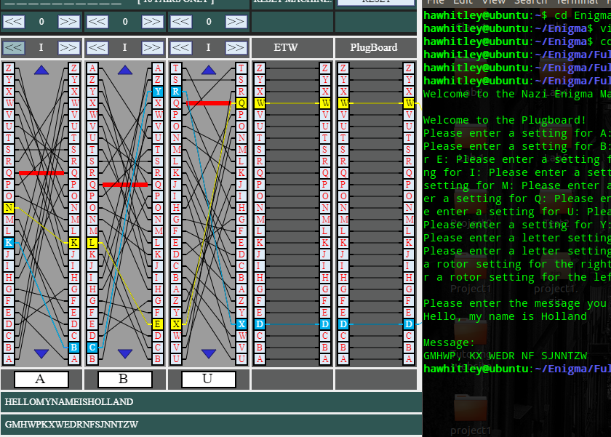
Test Results - Enigma
All tests passed (see documentation for details)
How I tested: Ran program with a simulator side by side to check results
Piotte 13 Simulator

Slide 19
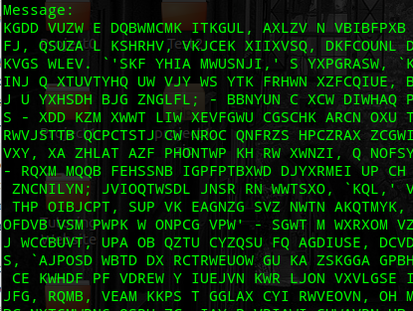
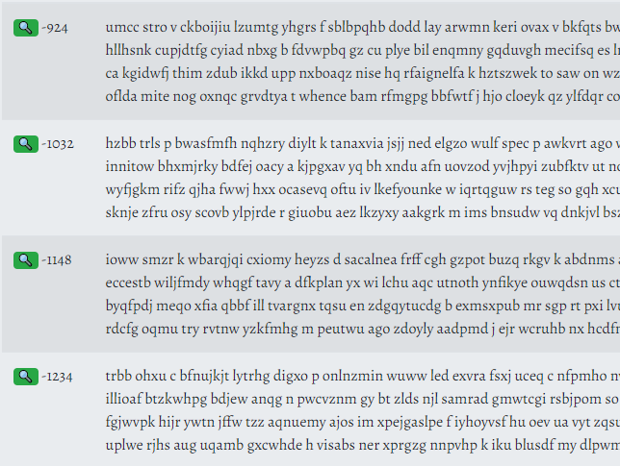
Test Results – Frequency Analysis
All failed (see documentation for details)
How I tested: Put plain text through program and resulting ciphertext through substitution/frequency analysis code breaker
Boxentriq decryptor

Slide 20

Test Results – Frequency Analysis
Why doesn’t it work?
Frequency analysis works on substitution ciphers
The Enigma machine changes its substitution cipher every letter
In other words, the same letter entered two times will likely have two different outcomes

Slide 21
How It was Originally Broken
Known text – “Heil Hitler” at the end of every message
Reverse engineered the encrypted message with the known text to get the component settings (with the knowledge of how the rotors moved)
Without this method – would have to reverse the rotor movements and then perform frequency analysis on it
Without the rotor movements changing the substitution cipher at every letter, frequency analysis can be used

Slide 22
Challenges Overcome
For the Enigma machine –
Oversimplified diagrams
Emulators that did not show the process
Not enough resources on the subject
For Frequency Analysis –
Very little practical advice on how to use it properly
Figuring out that it does not work with the Enigma machine after trying to figure it out for so long

Slide 23
Future Enhancements
Enigma Machine -
Extra Rotor Settings (IV, V, VI, VII, VIII, Beta, Gamma)
A Fourth Rotor
Extra Reflector Settings (Reflector C, Reflector B Thin, Reflector C Thin)
Ring Settings
Code Breaking –
Different methods such as known words
Effect of no white space or punctuation on code breaking

Slide 24
bibliography
http://users.telenet.be/d.rijmenants/en/enigmatech.htm#:~:text=The%20Enig ma%20machine%20is%20an,lamp%2C%20representing%20the%2 0encoded%20letter.
https://piotte13.github.io/enigma-cipher/
https://www.rapidtables.com/code/text/ascii-table.html
https://www.101computing.net/frequency- analysis/#:~:text=Frequency%20analysis%20consists%20of%20co unting,letters%20occur%20with%20varying%20frequencies.&text =This%20will%20help%20us%20decrypt%20some%20of%20the %20letters%20in%20the%20text.
https://www.boxentriq.com/code-breaking/frequency-analysis
https://www.boxentriq.com/code-breaking/cryptogram
https://etc.usf.edu/lit2go/147/the-works-of-edgar-allan-poe/5245/the-cask-of- amontillado/
https://www.poetryfoundation.org/poems/48860/the-raven
https://oiipdf.cdn.oii.ink/pdf/2f26c731-a7d9-410e-a9ce-9c046beb8d85.pdf

